Slide 1
3D Reconstruction from several images(structure from motion)
Project Presentation: CS676 (Computer Vision)
Anshu Avinash Pranjal Singh Sunil Kumar
10327122 10327511 10327742
anshuavi@iitk.ac.in spranjal@iitk.ac.in msunil@iitk.ac.in
GROUP-6
Advisor: Prof. Vinay P. Namboodiri

Slide 2
CONTENT
Motivation
SFM
Framework
Dataset
Feature Extraction
Fundamental, Essential and Camera Matrices
Reconstruction: Triangulation
Refinement: Bundle Adjustment
Results
References

Slide 3
motivation
We live in a 3D world
We see 2D images but perceive the world in 3D
Intelligent robot should have this 3D reconstruction capability

Slide 4
WHY SFM?
Structure and depth are inherently ambiguous from single views
Unknown
camera
viewpoints

Slide 5
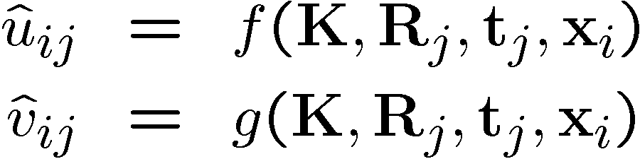
sfm
Given many points in correspondence across several images, {(u_{ij},v_{ij})}, simultaneously compute the 3D location x_{i} and camera (or motion) parameters (K, R_{j}, t_{j})

Slide 6
framework
Refinement by adding more views
Triangulation
Assume that camera is calibrated
3D Reconstruction from 2D points
Image Sequence
Feature Extraction & Matching
Computing
F-Matrix and E-Matrix
Camera Calibration

Slide 7
DATASET
Fountain P-11 Sequence
http://cvlabwww.epfl.ch/~strecha/multiview/denseMVS.html
Herz-Jesu-P8
http://cvlabwww.epfl.ch/~strecha/multiview/herzjesu_dense.html

Slide 8
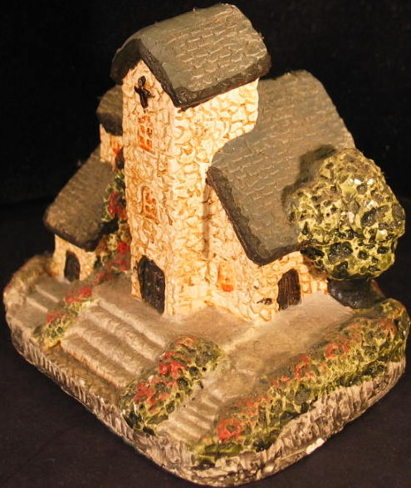
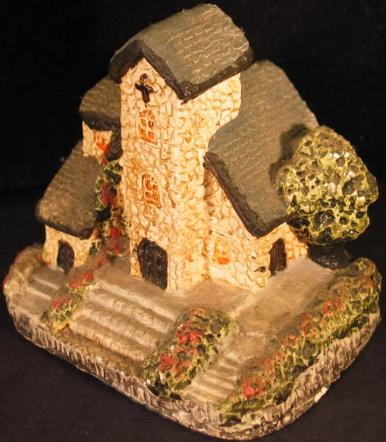
Feature correspondence
Area a
Image at t=t₀
(or left image)
Image at t=t₀+dt
(or right image)
8

Slide 9
Feature extraction
SIFT Features Detection
Feature Matching

Slide 10
Feature extraction
Optical flow is another alternative to get better matching
“Optical flow is the process of matching selected points from one image to another, assuming both images are part of a sequence and relatively close to one another”
Advantage: Process is usually faster and can accommodate matching many more points, making the reconstruction denser

Slide 11
Camera calibration
Determine camera parameters from known 3D points or calibration object(s)
internal or intrinsic parameters such as focal length, optical center, aspect ratio: what kind of camera?
external or extrinsic (pose) parameters: where is the camera?
Camera intrinsic and extrinsic parameters can be determined for a particular camera and lens combination by photographing a controlled scene.

Slide 12
Fundamental matrix(f)
Records motion between cameras
Used RANSAC to calculate F
Can be used to calculate Essential matrix which assumes usage of calibrated cameras
E = K^{T} * F * K

Slide 13
Essential matrix(E)
3 x 3 sized matrix
Can be used to recover projection matrix for each camera
Imposes a constraint between a point in one image and a point in the other image with x‘ E x=0
where x is a point in image one and x' is the corresponding point in image two.

Slide 14
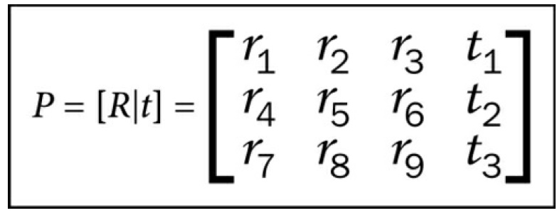
Camera matrix
Derived using SVD of Essential Matrix

Slide 15
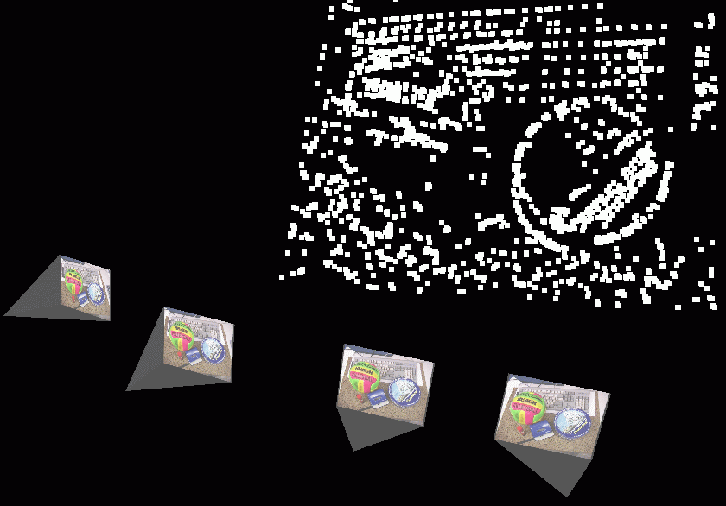
reconstruction
Recovering the 3D structure of the scene from the information we have i.e. 2D points and camera matrices
Triangulation Method
X
F
x

Slide 16
triangulation
Problem: Given some points in correspondence across two or more images (taken from calibrated cameras), {(u_{j},v_{j})}, compute the 3D location X
Problem: Rays usually do not intersect

Slide 17
triangulation
Approach: Linear Method
Two key equations arising from the 2D point matching and P matrices:
x=PX and x'=P'X
where x and x' are matching 2D points and X is a real world 3D point
If we rewrite the equations, we can formulate a system of linear equations that can be solved for the value of X, which is what we desire to find.
Ref: Triangulation, R.I. Hartley and P.Strum, 1997

Slide 18
Reconstruction from many views
Resection or camera pose estimation, also known as Perspective N-Point(PNP)
Try to solve for the position of a new camera using the scene points we have already found
We have used SolvePnPRansac function available in OpenCV

Slide 19
Refinement of reconstruction
Known as Bundle Adjustment
Both the position of the 3D points and the positions of cameras are optimized, so re-projection errors are minimized
We have used SSBA(Simple Sparse Bundle Adjustment) Library

Slide 20
3D visualization
Used Point Cloud Library(PCL) for 3D Visualization

Slide 21
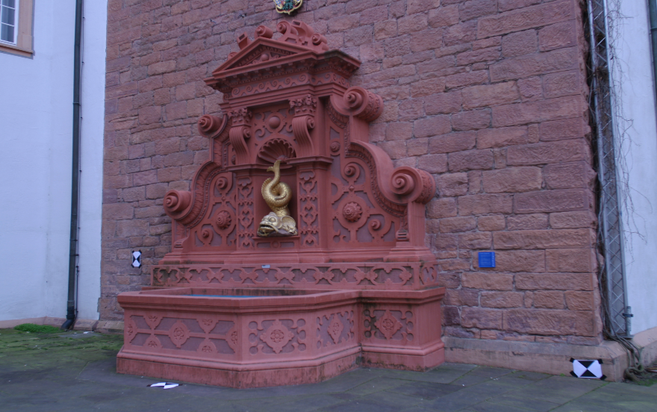
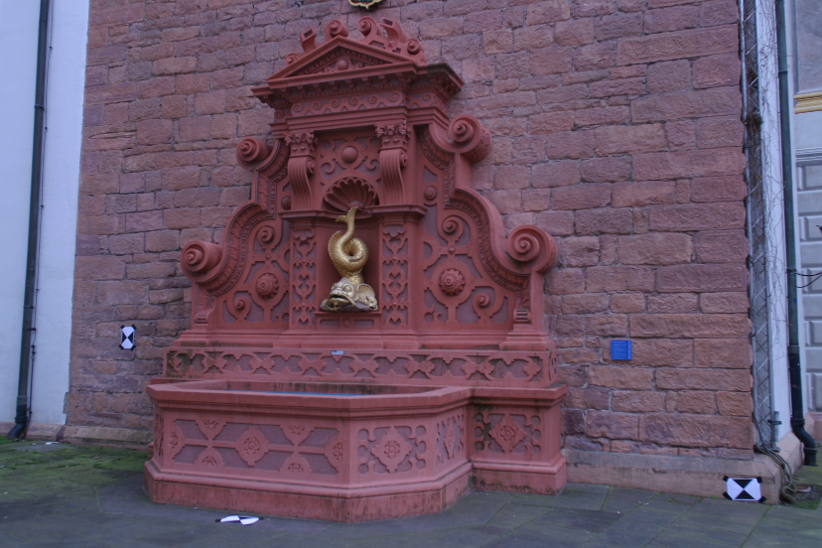
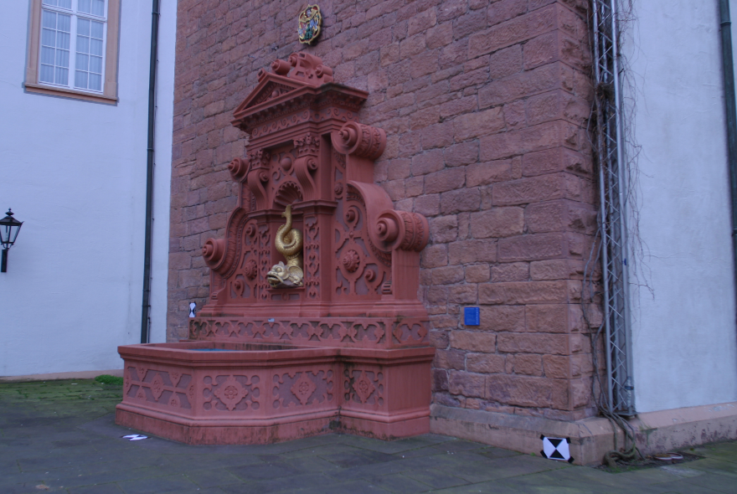
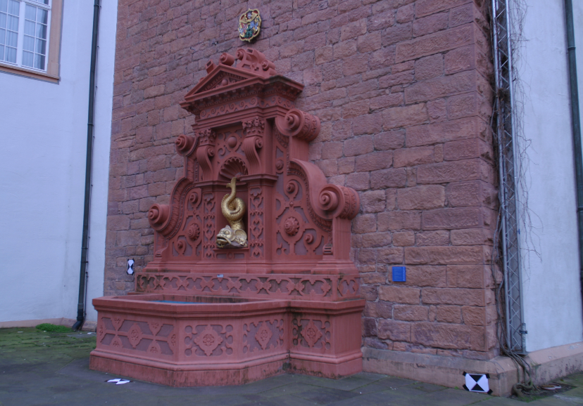
Dataset:Fountain P-11 Sequence

Slide 22
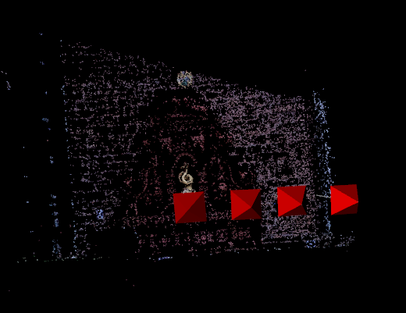
result
3D points recovered from the set of 4 images

Slide 23
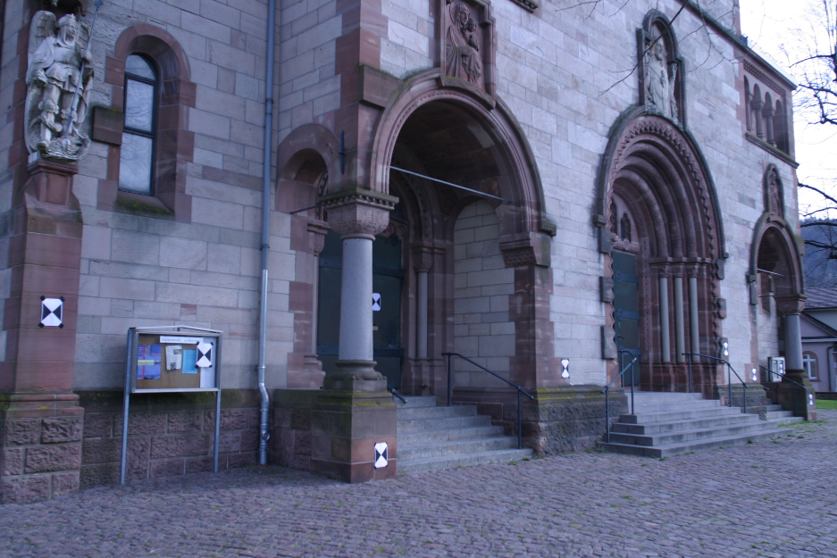
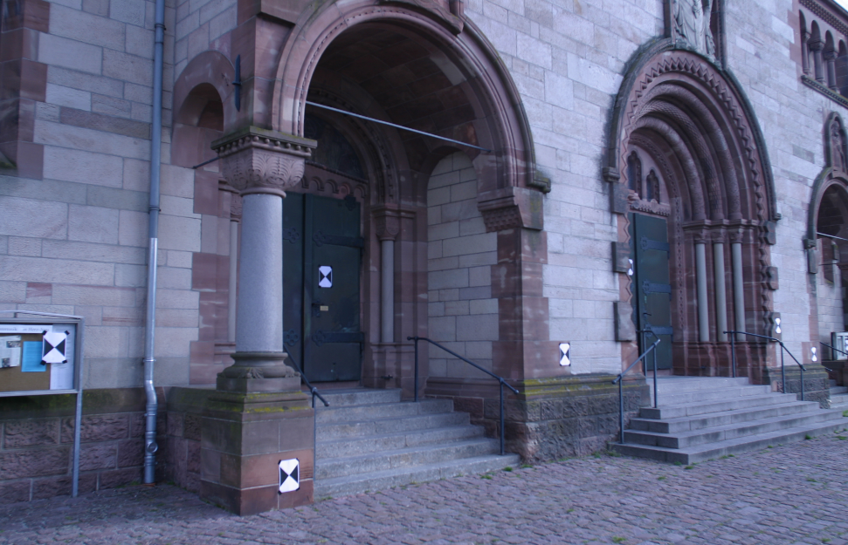
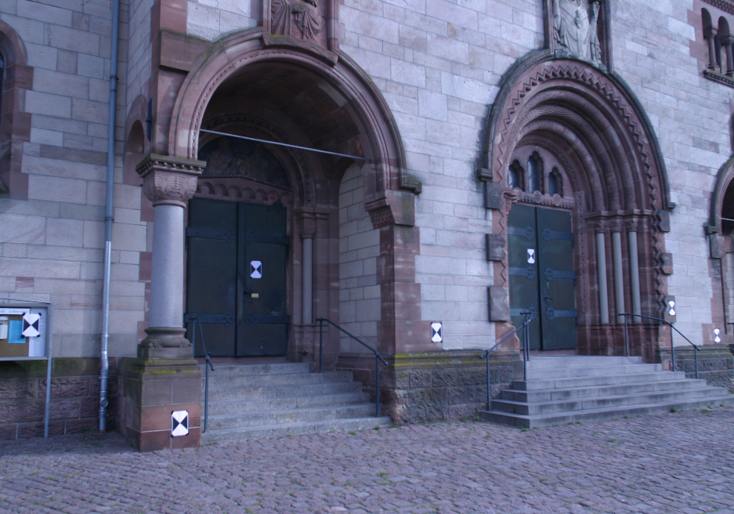
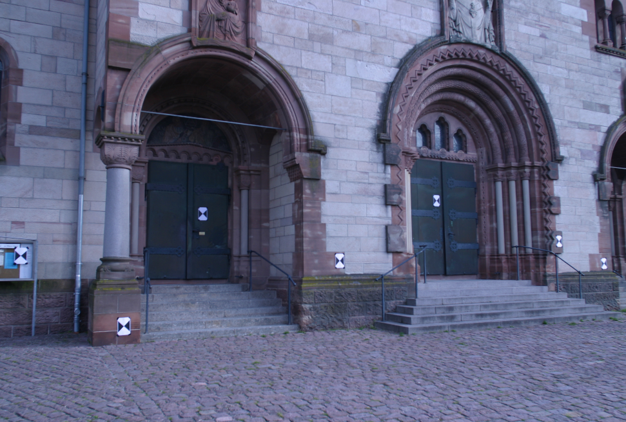
Dataset:HERZ-JESU-P8

Slide 24
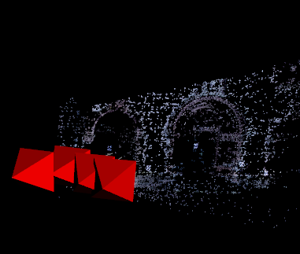
RESULT
3D points recovered from the set of 4 images

Slide 25
MORE WORK
Can have better Triangulation Method that minimizes the re-projection error
There are many state-of-the art tools available
E.g. Bundler, VisualSFM, LibMV

Slide 26
REFERENCES
R. I. Hartley. and A. Zisserman. Multiple View Geometry. Cambridge University Press, 2000.
Triangulation, R.I. Hartley and P.Strum, 1997

Slide 27
THANK YOU!!
QUESTIONS??

